Slide 1

DZW PRO series handheld laser cleaning machine--technical solution

Slide 2
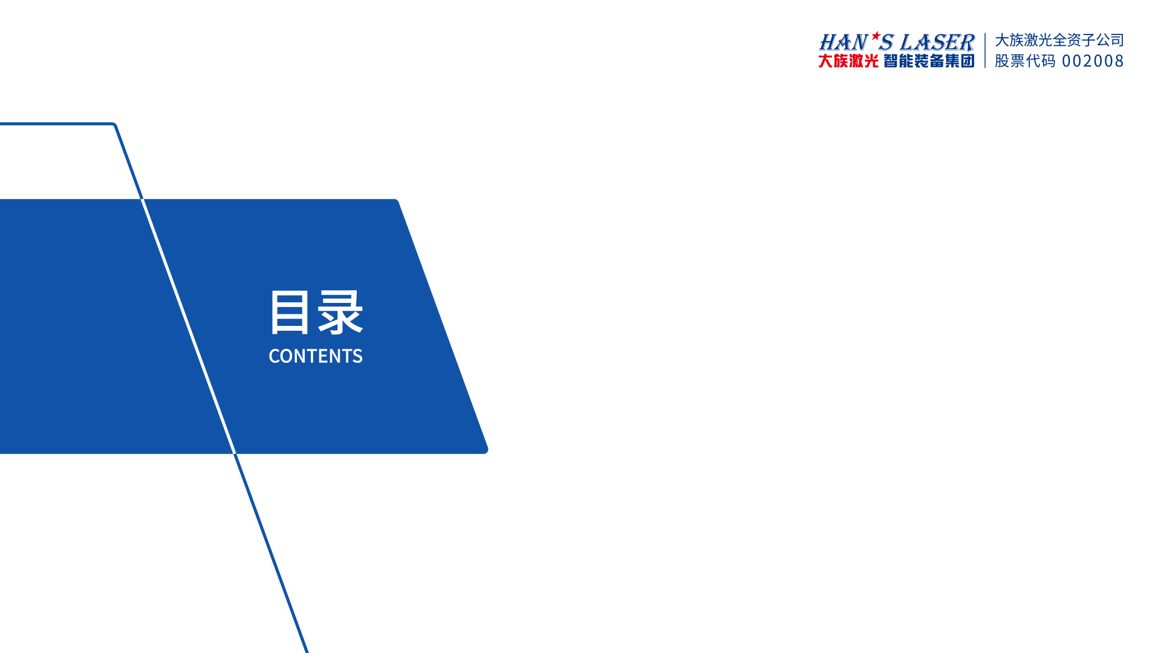
01
Equipment introduction
02
Laser cleaning advantages
03
Equipment usage precautions
04
Laser cleaning process parameters
05
Applications and cases
06
Parts List

Slide 3
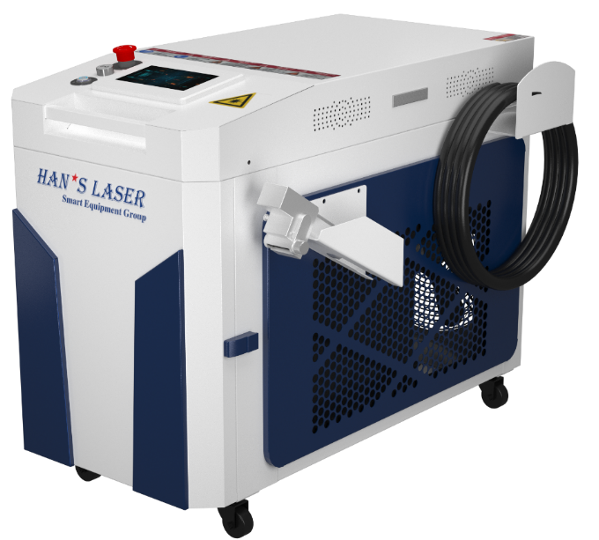
01
Equipment Introduction-Equipment Features
Features
☛""Green cleaning"" is environmentally friendly and does not require the use of any chemicals.
☛ High cleaning degree, uniform cleaning, high cleaning efficiency, low labor intensity and low labor cost.
☛No grinding, no contact, no damage to the substrate or workpiece, suitable for cleaning objects of various materials.
☛The operation is simple and requires no professional skills. You can start working directly after simple training.
☛It can be configured with robots, positioners, rotating axes, etc. to achieve automatic cleaning.

Slide 4
01
Equipment Introduction-Equipment Specifications
Overall dimensions：1500W：1080*580*780
2000W：1080*580*780
3000W：1100*580*900
Laser power：1500W、2000W、3000W
Machine power consumption：8.5KW 11KW 16.5KW
equipment weight：102KG 111KG 145KG
Input voltage：AC220V,50Hz（3KW laser with 380V voltage）
Laser wavelength：1064±10nm
Fiber length：Standard 10m (can be customized)
Laser gun head: cleaning gun
Swing arc width：0-300mm
swing frequency：10-100Hz
Endpoint optimization: -20-20 (eliminates uneven light emission at both ends of the cleaning track. Depending on the actual situation, reducing the value may make the endpoint energy larger or smaller. The same applies to increasing the value. Please adjust to ideal state.）
Cooling system: water cooling
Working temperature：10℃~40℃
Working environment humidity: <70%, no condensation
Storage environment temperature: -10℃~60℃

Slide 5
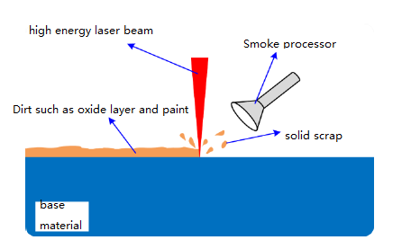
01
Equipment Introduction-Laser Cleaning Principle
Basic principles of laser cleaning:
Laser is a new cleaning method based on the interaction between high-energy-density laser beams and materials. The vibration effect uses high-frequency lasers to impact the surface of the object to be cleaned. The beam is converted into sound waves and returns from the underlying surface, interfering with the incident wave, thereby producing Resonance causes the contaminants to fragment; the thermal expansion effect uses the difference in the absorption coefficient of laser energy of a certain wavelength between the substrate and the surface contaminants to cause the contaminants to absorb the laser energy and thermally expand instantly, forming a large detachment acceleration and overcoming the substrate's impact on the contamination. It falls off due to the adsorption force of the substance; the photodecomposition and phase change of the molecules can instantly vaporize, decompose, and evaporate the pollutant molecules.

Slide 6
01
Equipment Introduction-Configuration Table
NO. | Configure components |  | DZW PRO series | quantity | unit | Remark
1 | Handheld laser cleaning host | fiber-optic laser | 1500W/2000W/3000W | 1 | set
2 |  | fiber optic cable | 10m | 1 | piece
3 |  | Control System | Han's laser customization | 1 | set
4 |  | cooling system | Water cooler cooling capacity 4kW/5.2kW/7.5kW | 1 | set
5 | Clean focusing lens |  | Standard configuration | 1 | piece
6 | Laser protective glasses |  | Standard configuration | 1 | pair | 1064 band
7 | Protective lenses |  | Standard configuration | 5 | piece
8 | Whole machine test report |  | Standard configuration | 1 | Page
9 | Equipment delivery list |  | Standard configuration | 2 | Page
10 | Equipment training report |  | Standard configuration | 2 | Page
11 | Equipment instruction manual |  | Standard configuration | 1 | Page
Consumables used: collimating lens, focusing lens, reflector, protective lens.
User-prepared: protective gas, cooling water, pressure reducing valve, 6mm air pipe adapter and adapter air pipe.

Slide 7
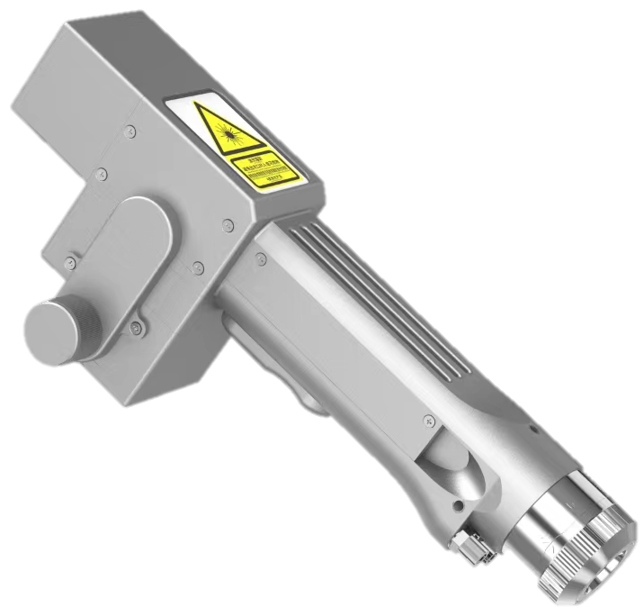
01
Equipment Introduction-Cleaning Head
NO. | parameters
1 | Input voltage | AC220V,50/60Hz
2 | Placement environment | Smooth, no vibration, no impact
3 | cooling method | water cooling
4 | Applicable power | ≤3000W
5 | collimation | D16×5mm， F60
6 | focus | D20×3.5mm， F800
7 | reflection | 20×15.2×T1.6mm
8 | Protective lenses | D30×5mm
9 | Scan Width-Clean | 0-300mm
10 | Support maximum air pressure | 15bar
11 | Focus adjustment range | -10~+10mm
12 | weight | 0.7kg
13 | Working temperature | 10~40℃
14 | Working environment humidity | ＜70%
Features of handheld cleaning head:
Unique air knife design: The unique outlet "air knife" design can greatly increase the flow rate of the light outlet protective gas and better prevent lens contamination.
Swing function, swing amplitude 0~300mm adjustable
Optimize the control program to make the overall cleaning effect more uniform and consistent
Multiple safety alarms and active safety power-off and light-off settings
Controllable parameters and high repeatability. To stabilize the mechanical structure and lens state, only the laser power must be stable and the process parameters must be repeatable, greatly improving efficiency.

Slide 8
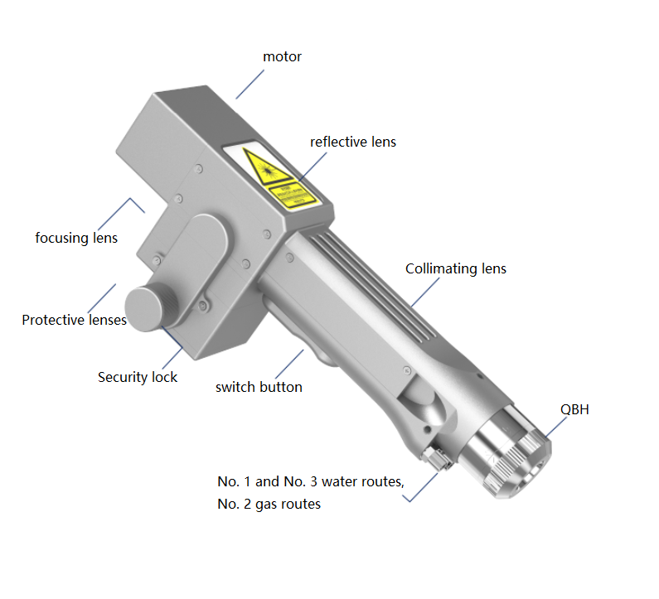
01
Equipment Introduction-Cleaning Head Structure Diagram

Slide 9
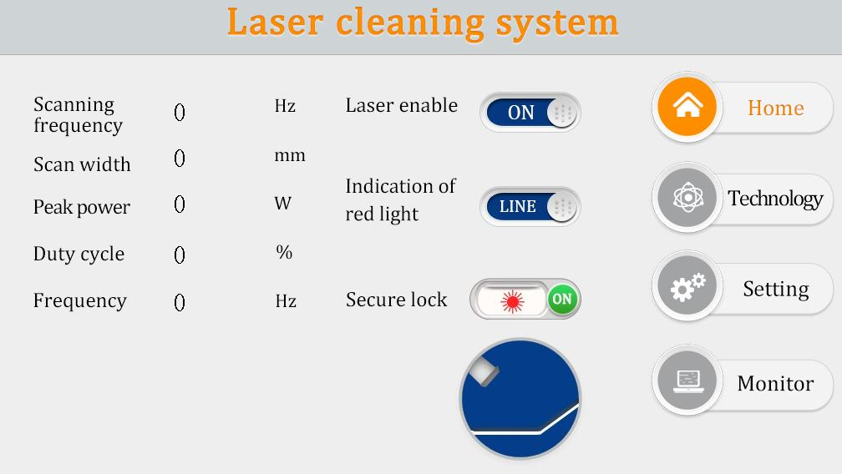
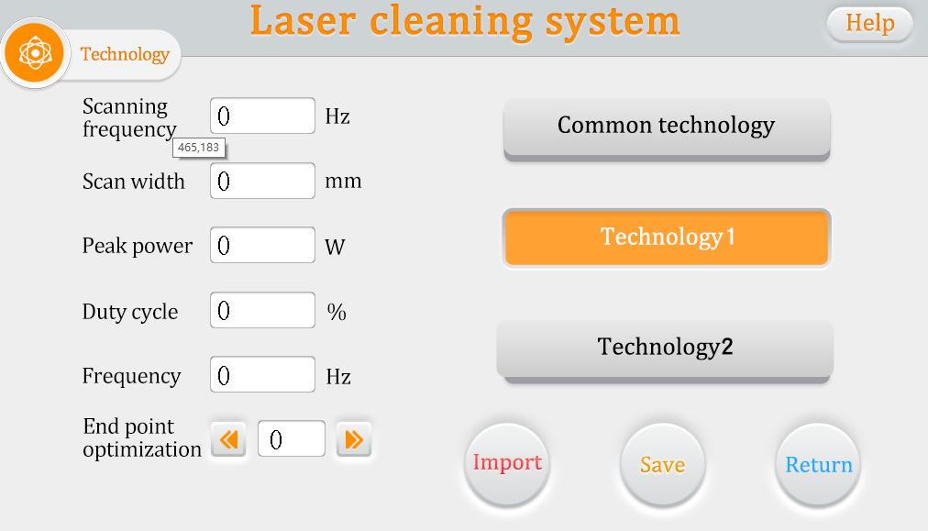
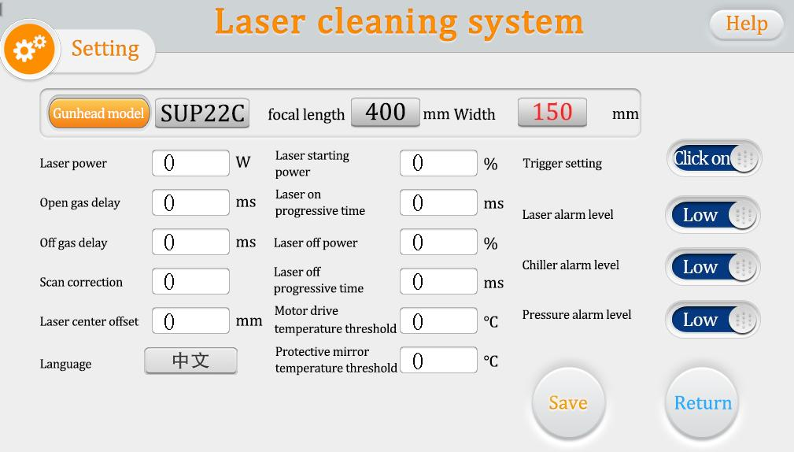
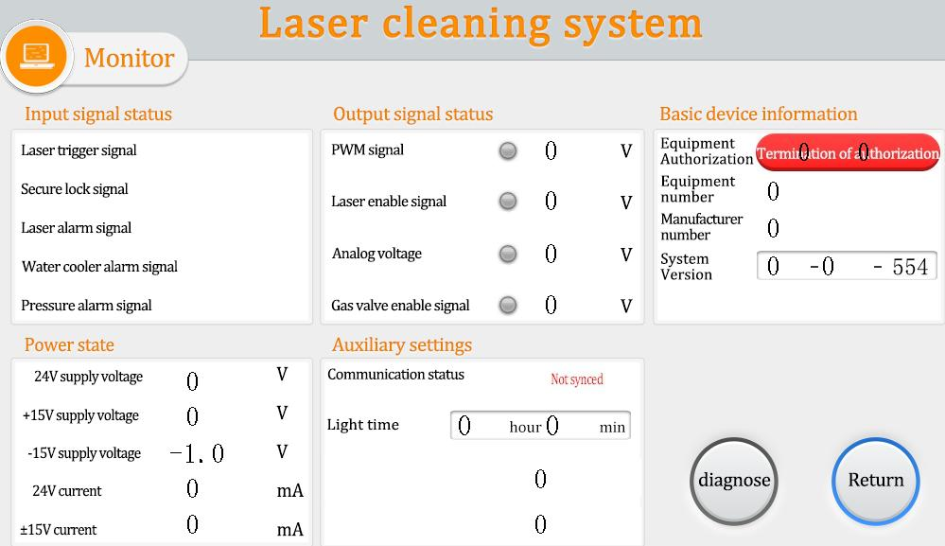
01
Equipment Introduction-Operation Interface
Home page |  | technology
setting |  | monitor

Slide 10
02
Advantages of laser cleaning-compared to traditional cleaning
item | Handheld laser cleaning | Industrial cleaning | Mechanical cleaning | dry ice cleaning
Cleaning method | Contactless type | contact type | contact type | contact type
Workpiece damage | none | have | have | have
Cleaning efficiency | high | Low | Low | Low
Consumable costs | electricity | chemical cleaning agent | Sandpaper, grinding wheel | dry ice
Cleaning effect | High cleanliness | Generally, unevenly | Generally, unevenly | Generally, unevenly
Safety and environmental protection | No pollution | polluted environment | polluted environment | polluted environment
manual operation | Easy to operate, handheld or automated | The process is complex and requires high requirements on operators | It is labor intensive and requires protective measures. | Easy to operate, handheld or automated

Slide 11
02
Advantages of laser cleaning-cleaning ability
cleaning ability
power/w | material | cleaning speed | Effective beam/cleaning range | depth of cleaning | Cleaning efficiency (square/H)
1500 | floating rust | 50mm/S | 300mm | 20um | 15
1500 | paint | 50mm/S | 300mm | 100um | 6
1500 | rust | 50mm/S | 300mm | 120um | 4
2000 | floating rust | 50mm/S | 300mm | 20um | 20
2000 | paint | 50mm/S | 300mm | 100um | 8
2000 | rust | 50mm/S | 300mm | 120um | 5
3000 | floating rust | 50mm/S | 300mm | 20um | 30
3000 | paint | 50mm/S | 300mm | 100um | 14
3000 | rust | 50mm/S | 300mm | 120um | 9

Slide 12

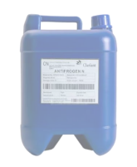
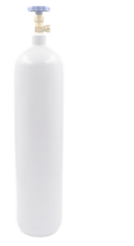
03
Equipment usage precautions
power supply： 6 square wire diameter wire power supply, single-phase AC220V50Hz, (3KW laser with 380V voltage), 63A circuit breaker, separately grounded. Note: It cannot be used with the same power busbar as arc welding, high-power pulse welding, and resistance welding, as it may cause interference or damage to the equipment; the grounding resistance must be ≤ 4Ω. If the requirements cannot be met, repeated grounding must be adopted; if on-site laser welding and argon arc When welding is used at the same time, the ground wire cannot be shared. An independent ground wire must be used to avoid static electricity.
Cooling water：Party A (user) provides about 20L of cooling circulating water. Distilled water is the best. It is recommended to use Watsons distilled water. The cooling water should be replaced every 1-2 months.。
Cleaning gas: 1. Party A (user) must prepare its own protective gas compressed air not less than 0.5MPa (no oil and water), flow pressure reducing valve (output pressure ≥ 0.5MPa), and flow meter 2. Other inert gases.
antifreeze：Party A (user) purchases antifreeze in advance (Clariant - ethylene glycol is recommended), and the volume ratio of antifreeze is 20%. When the temperature is below 0°C, antifreeze needs to be added to the cooling water.
Confirmation of laser focus: 1. By scanning back and forth from far to near, the focus is when the sound is the loudest and the sparks are the largest. At this time, cleaning is performed according to this distance, and the laser energy is the strongest. (about 800mm distance) 2. Please keep the distance between the gun tip and the workpiece surface stable, and keep your hand speed even.
Note: Cooling water, antifreeze, protective gas, and welding wire need to be prepared by the user.
Precautions for use：
When using the device, please handle it with care and do not drop it while holding the gun head.
Optical fibers are welded inside the cable package. Please do not step on, twist, impact, heavy pressure or excessive bending, etc.
When replacing the protective mirror, make sure to protect it from dust
When using it for the first time, be sure not to emit light when the red light is not visible
Be sure to take protective measures when going out, wearing gloves, protective glasses, etc.

Slide 13
04
Laser cleaning process parameters
Peak power: laser welding power. When other parameters remain unchanged, the higher the laser power, the deeper the cleaning penetration. |  | Scan width: the amplitude of motor swing. When the other parameters remain unchanged, the wider the swing arc width, the larger the cleaning width, and the shallower the penetration depth. The swing arc range is 10~300mm.
scanning frequency： The speed at which the lens motor swings. When the other parameters remain unchanged, the slower the oscillation frequency, the weld will appear wavy and the penetration will be deeper; the faster the oscillation frequency, the more uniform the formation will be, but the penetration will become shallower. Commonly used frequency is 50 hz. |  |  | Defocus amount: The focus position is the laser focus position, and the plane where the focus is located is the focal plane. Based on the workpiece surface, the focal plane has negative defocus inside the workpiece and positive defocus outside the workpiece.
Cleaning speed: Manually control the speed and try to keep it as constant as possible to ensure even cleaning of the workpiece. | Duty cycle: refers to the proportion of light emitting time to the total time within a pulse cycle. This is generally set to 100%. |  | Laser frequency: Refers to the number of times of light emission per second. The general setting here is 2000Hz.

Slide 14
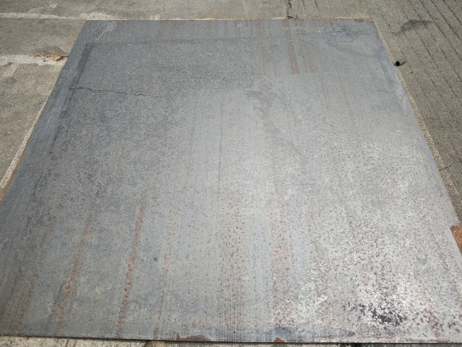
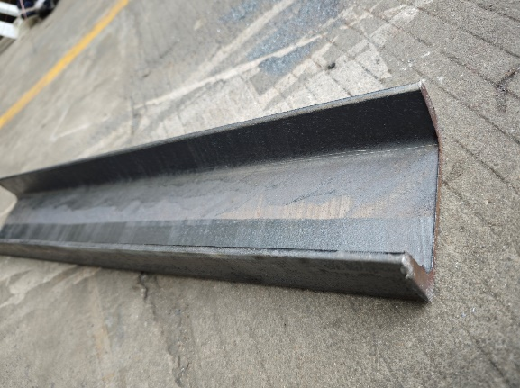
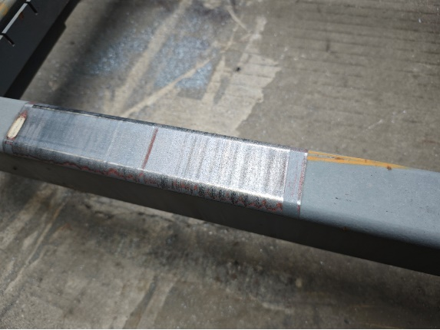
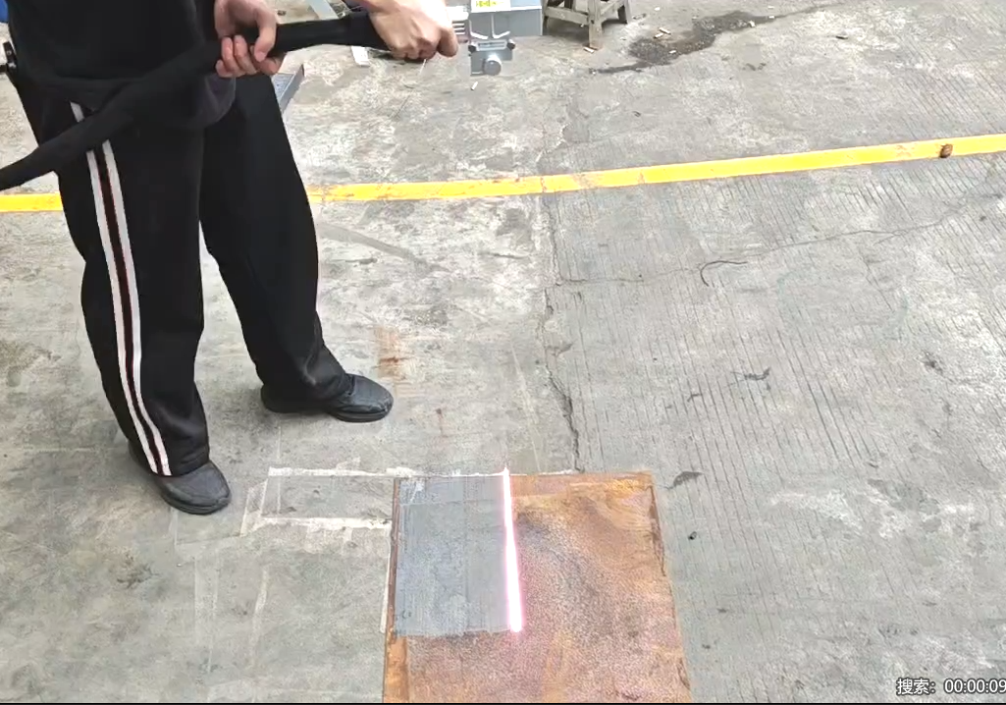
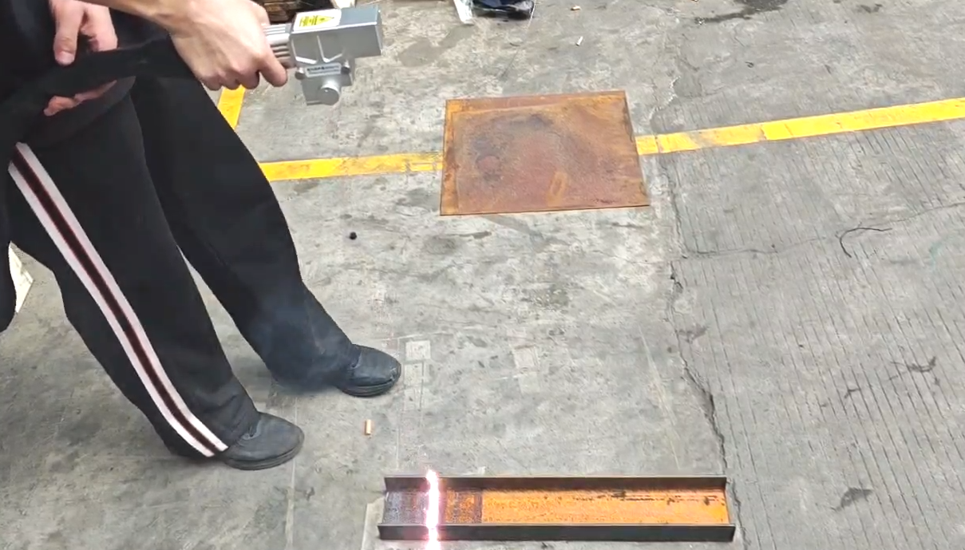
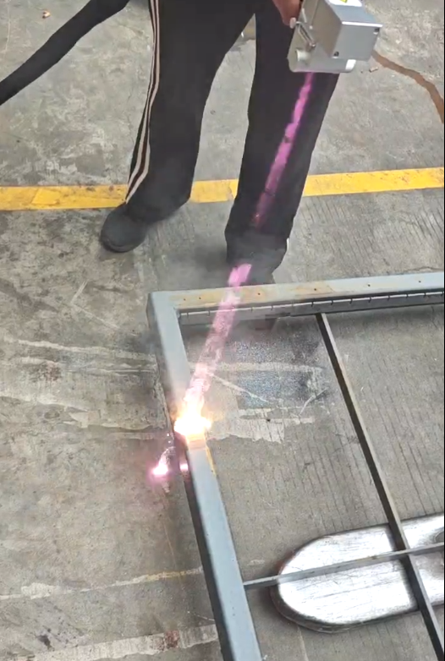
05
Applications & Cases
Floating rust
Corrosion
Paint
销售热线： 400-666-4000 网址： www.hansme.com

Slide 15
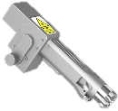


06
Parts and accessories selection list
NO. | Material coding | Material name | Model/drawing number | unit | picture | Remark
1 | 98.06.0009316 | Handheld laser welding gun | SUP22C | Pcs
2 | 04.17.0001014 | Protective lenses | D30*T5-1064±10nm | Pcs
3 | 04.06.0000988 | reflective lens | 20*15.2*T1.6-1064±10nm | Pcs
4 | 04.05.0005186 | focusing lens | D20*3.5F800-1064±10nm | Pcs
5 | 04.05.0005185 | Collimating lens | D16*5F60-1064±10nm | Pcs
6 | 04.25.0001920 | Protective/Focusing Seals | VS26*34*2.7(Lower protection/focus) | Pcs
7 | 04.25.0001919 | Protective/Focusing Seals | VS29*33*2.2(Lower protection/focus) | Pcs

